Slide 1

CS47: Cross-Platform Mobile Development
Lecture 3B: Exercise on Interactive Components
James Landay
Abdallah AbuHashem
Tiffany Manuel
Cisco Vlahakis
Vy Mai
Fall 2019
https://cs-47.stanford.edu
cs-47.slack.com
Notes:
Welcome to the first part of Lecture 3. Today we’re going to talk about user interactive components.
This includes the TextInput and Lists

Slide 2

Live Exercise
To-Do List
Run npm install
Open with Expo

Slide 3
Live Exercise
To-Do List
Run npm install
Open with Expo
OR
Run git stash
Run git pull
Open with Expo

Slide 4
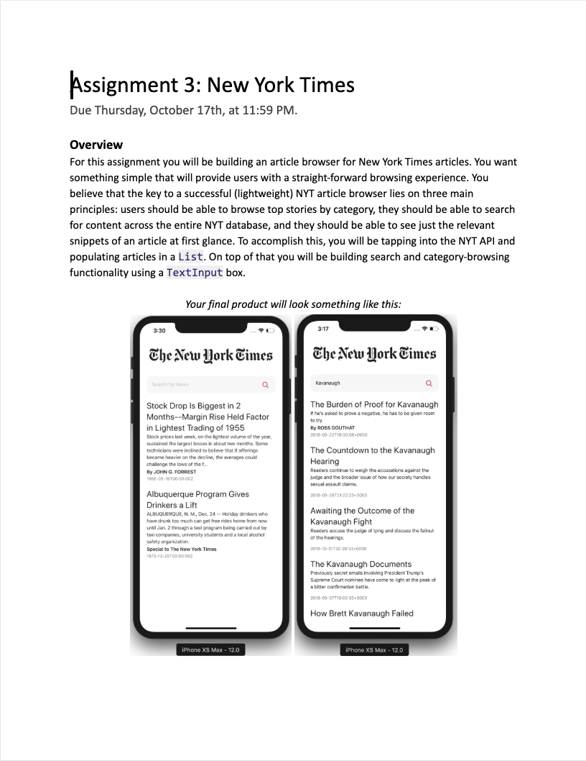
Due Thursday, October 17th
Notes:
Assignment 3 is released today
Tiffany’s OH moved to 4pm on Thursday in Huang basement bc career fair

Slide 5

Overview for today
Quick recap
Exercise
ToDo list app to use TextInput, FlatList and Functional Components
Notes:
Flexbox: recap from last lecture.

Slide 6
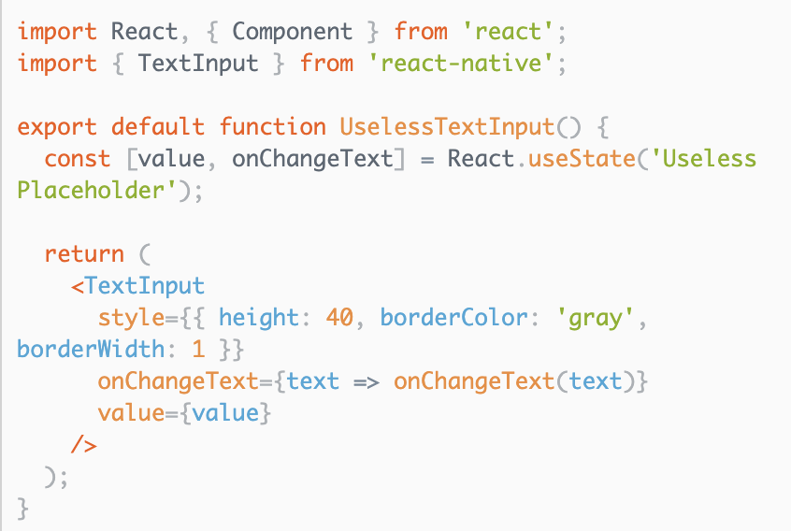
TextInput
Allows for the intake of text by the user
Two important props
onChangeText listens to keystrokes
value displays the text itself
Additional props
placeholder is text shown when nothing is typed
Snack: https://snack.expo.io/BJNX1__xZ

Slide 7
FlatList
Allows for the display of a list with scrolling built in
Three important props
data, what do you want to show?
renderItem renders an item in the flatlist
This is where you specify the UI layout of each item in data
keyExtractor returns a unique key for every item
Common cause of YellowBox warnings is to incorrectly assign keys
Snack: https://snack.expo.io/@bacon/flatlist

Slide 8
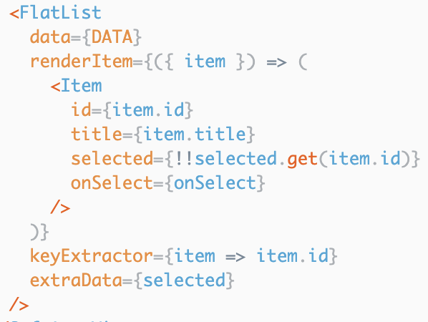
FlatList
Array of objects
Returns an object that represents an instance of the data array
Extracts which field should be read as the key, usually an id

Slide 9
Follow new code
https://reflect.sh/finicky-knee
Live Exercise
To-Do List
Complete parts 1 & 2
Notes:
Flexbox: recap from last lecture.

Slide 10
Demo Step 3
Notes:
Flexbox: recap from last lecture.

Slide 11
Remember functional components
Notes:
Flexbox: recap from last lecture.

Slide 12
Functional Component
A Component that is declared like a JS function.
const App = () => {
return ( <View style={styles.container}> <Text>Hello World!</Text> </View>
);
}

Slide 13
Functional Component
A Component that is declared like a JS function.
const App = (greeting) => {
return ( <View style={styles.container}> <Text>{greeting}</Text> </View>
);
}
Notes:
Since it is a function, you can pass in variables like you would to a normal function. This is equivalent to passing a prop into a class component.
What if we wanted to make a functional component interactive too? Until recently, we weren’t able to because there was no state in functional components. Then, React introduced a way to apply the state feature to functional components.

Slide 14
Functional Component
A Component that is declared like a JS function.
const App = (props) => {
return ( <View style={styles.container}> <Text>{props.greetings}</Text> </View>
);
}
Notes:
Since it is a function, you can pass in variables like you would to a normal function. This is equivalent to passing a prop into a class component.
What if we wanted to make a functional component interactive too? Until recently, we weren’t able to because there was no state in functional components. Then, React introduced a way to apply the state feature to functional components.

Slide 15
Hooks
Functions that allow you to “hook into” React state and life cycle features from function components.
Notes:
We’ll talk about component life cycles later in the course.

Slide 16
Hooks
Functions that allow you to “hook into” React state and life cycle features from function components.
Two Rules of Hooks
1) Only call Hooks at the top level
2) Only call Hooks from React
functional components
Notes:
Only call Hooks at the top level. Don’t call Hooks inside loops, conditions, or nested functions.
Only call Hooks from React function components. Don’t call Hooks from regular JavaScript functions.
There are a few built-in hooks already provided by React, but for now we will just look at one: useState.

Slide 17
state object
(Class Components)
useState Hook
(Functional Components)
const [x, setX] = useState(z)
setX(y)
import { useState } from 'react';
state = { x: z }
this.setState({ x: y })
Functional Components
Hooks
Notes:
We already know about the state object that we can use with class components, and the useState Hook is basically the same idea, but with functional components.
Array destructuring.

Slide 18
Live Exercise
To-Do List
Complete part 4
Notes:
Flexbox: recap from last lecture.

Slide 19
Due Thursday, October 17th
Notes:
Discuss more at the end of class, if we have time.

Slide 20
CS47: Cross-Platform Mobile Development
Lecture 3A: User-Interactive Components (TextInput + Lists)
James Landay
Abdallah AbuHashem
Tiffany Manuel
Cisco Vlahakis
Vy Mai
Fall 2019
https://cs-47.stanford.edu
cs-47.slack.com

